Slide 1
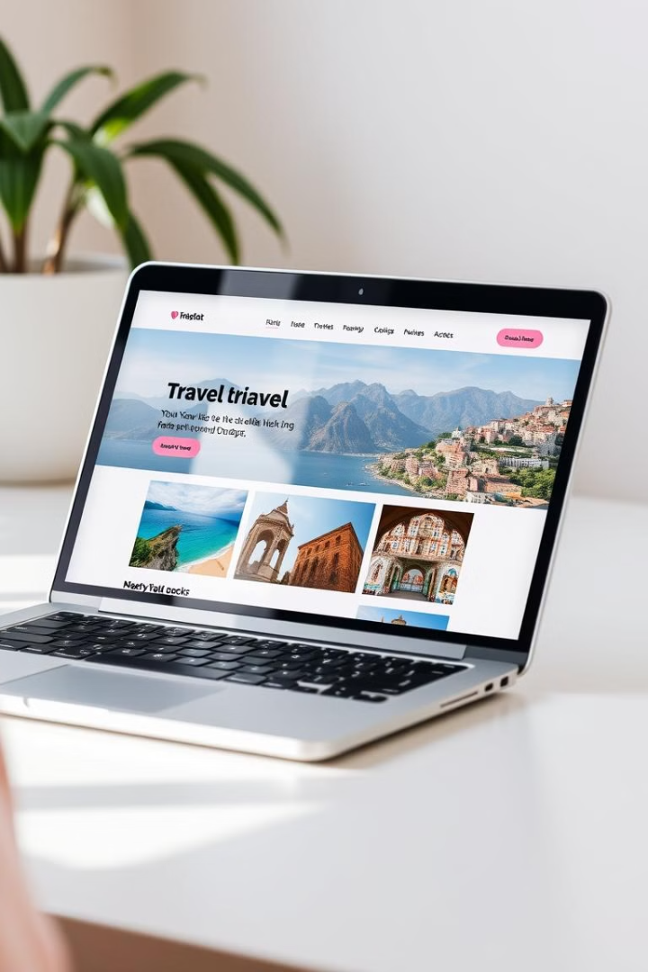
Majestic Journeys: A Travel Website
This presentation will delve into the development and features of a travel website titled Majestic Journeys.
Sumit Thori

Slide 2
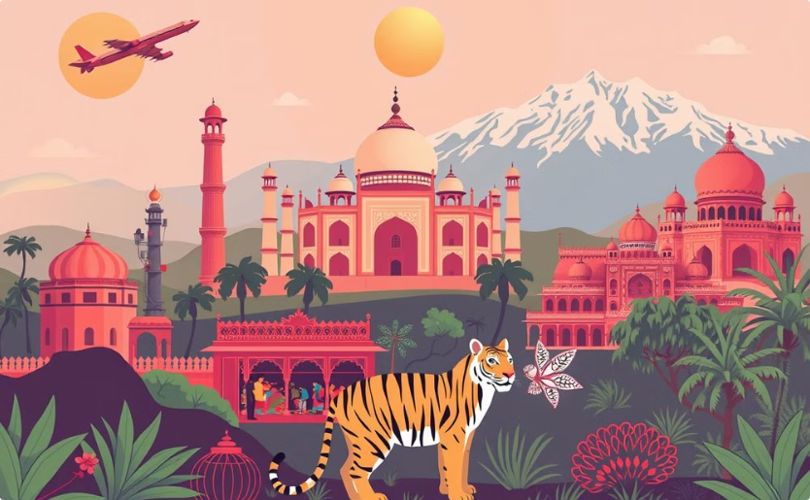
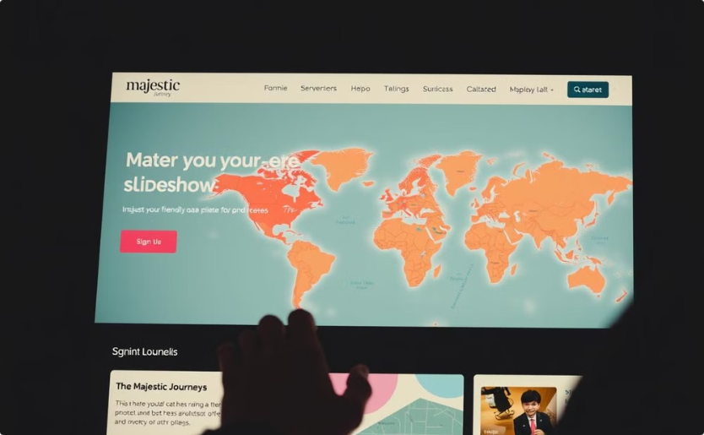
Website Overview
Purpose
Features
Showcase tours and packages in India.
Smooth navigation, responsive design, interactive elements.

Slide 3
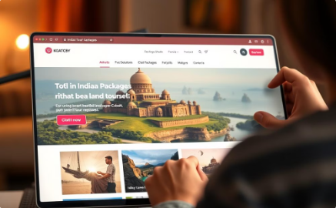
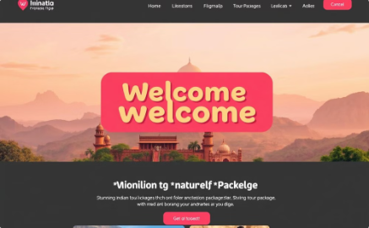
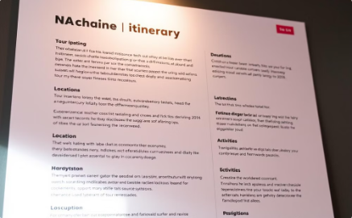
Key Features of Majestic Journeys
Smooth Scrolling Navigation
Personalized Welcome Alert
Detailed Tour Information
Effortless transition between tour packages and destination information, enhancing user experience. Majestic Journeys employs a smooth scrolling navigation system, allowing users to seamlessly glide through captivating images of Indian landmarks, detailed tour itineraries, and booking information. This intuitive design ensures a delightful and frustration-free browsing experience, maximizing engagement and showcasing the beauty of India.
Engages users with a brief, customized greeting upon landing on the Majestic Journeys homepage. This dynamic greeting uses geolocation to personalize the message, perhaps including local weather or a short greeting in the local language. This element creates a friendly and welcoming first impression, enhancing user engagement and reflecting the personalized touch of Majestic Journeys.
Comprehensive descriptions of each tour, including itineraries, pricing, and accommodation details. Each tour page includes a detailed itinerary, outlining each day's activities with precise timing and clear descriptions. Pricing is fully transparent, and high-quality images of accommodations are prominently displayed, ensuring users have all the information needed to make a confident booking decision.

Slide 4
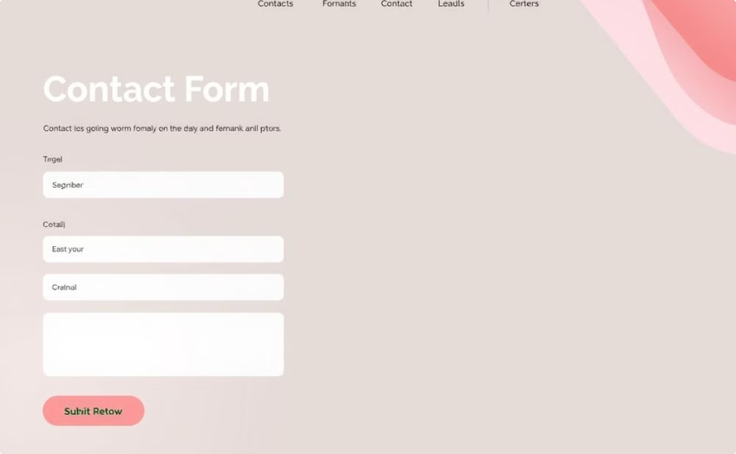
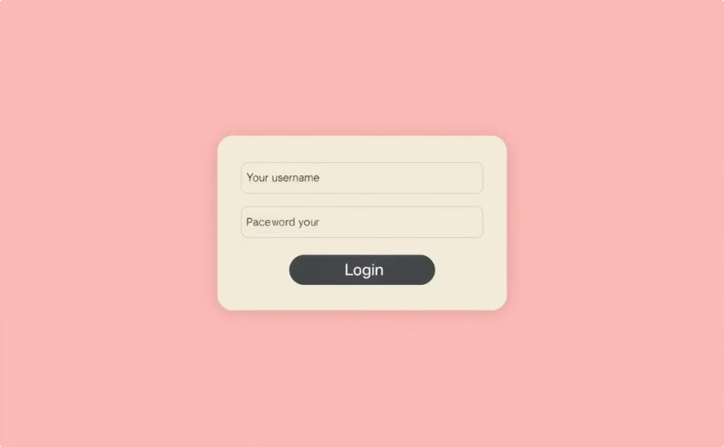
Interactive Elements
Contact Form
Login Modal
A user-friendly contact form allows visitors to easily send inquiries directly to Majestic Journeys. The form dynamically sends emails, including attachments if necessary. It's designed for rapid response and confirmation to users. The form is validated client-side to prevent errors and improve the user experience.
A secure login modal provides access to personalized features for returning users. This modal uses basic JavaScript validation to ensure accurate login details, providing immediate feedback to prevent incorrect inputs. The modal's design is clean and unobtrusive, minimizing disruption to the user experience.

Slide 5
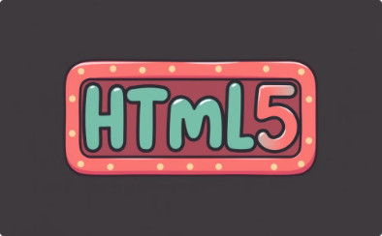

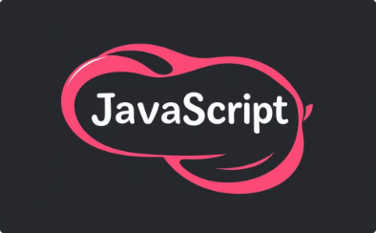

Technical Foundation
HTML5
CSS3
JavaScript
PHP
Provides the fundamental structure and semantic markup, ensuring accessibility and SEO.
Styles visual elements, including layout, typography, and animations. Responsive design is a key feature.
Facilitates dynamic and seamless user interactions. Delivers an enhanced and engaging digital experience.
Handles server-side processing, secure data transmission, and dynamic form handling.

Slide 6


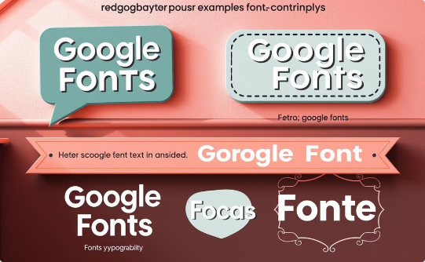
External Libraries
Font Awesome
Boxicons
Google Fonts
Provides a comprehensive set of vector icons, enhancing the visual appeal of interactive elements.
Used to supplement Font Awesome, providing additional icon choices for website features and functionality.
Integrates high-quality, web-safe fonts for readability and aesthetic consistency across website pages.

Slide 7

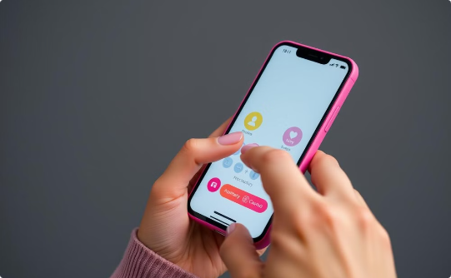
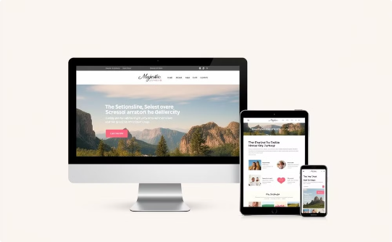
Conclusion
Seamless Booking & Support
Intuitive Trip Planning
Responsive Design for Effortless Access
Majestic Journeys provides a streamlined booking process, secure payment options, and responsive customer support via our user-friendly contact form for assistance throughout your journey.
Plan your perfect trip with our intuitive interface. Access personalized features with our secure login modal, managing your itinerary seamlessly across devices thanks to our responsive design.
Access and manage your travel plans effortlessly on desktops, tablets, and smartphones. Our responsive design ensures a consistent, enjoyable experience, no matter your device.

